Slide 1
CS 4048 Data Science
Instructor: Dr. Kashif Zafar
January 27, 2026
Graphical Displays
Box Plot, Histogram, Line Chart, Parallel Coordinate Plot and Scatter Plot, Quantile Plot, Q-Q Plot
Lecture No. 2b

Slide 2
Graphic Displays of Basic Statistical Descriptions
Boxplot: graphic display of five-number summary
Histogram: x-axis are values, y-axis repres. frequencies
Quantile plot: each value x_{i} is paired with f_{i} indicating that approximately 100 f_{i} % of data are ≤ x_{i}
Quantile-quantile (q-q) plot: graphs the quantiles of one univariant distribution against the corresponding quantiles of another
Scatter plot: each pair of values is a pair of coordinates and plotted as points in the plane

Slide 3
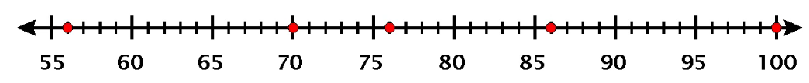
Box and Whisker Plot (aka Boxplot)
Boxplot is helpful in a lot of ways!
An extreme value that is at abnormal distance from other values.
Can be used to find Outliers!
IQR
What distance is abnormal?
What is an outlier?
MIN
Q1
Median
Q3
MAX

Slide 4






Outlier Detection with IQR
$$IQR=Q3 −Q1$$
$$OutlierThreshold=1.5×IQR$$
$$IQR=86 −70=16$$
IQR
$$OutlierThreshold=1.5×16=24$$
$$Outlier= Q1 − OutlierThreshold$$
$$Outlier= Q3 + OutlierThreshold$$
MIN
Q1
Median
Q3
MAX
Useful Article: https://www.thoughtco.com/what-is-the-interquartile-range-rule-3126244

Slide 5
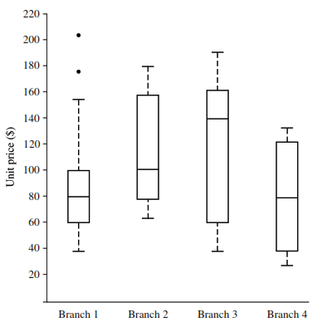
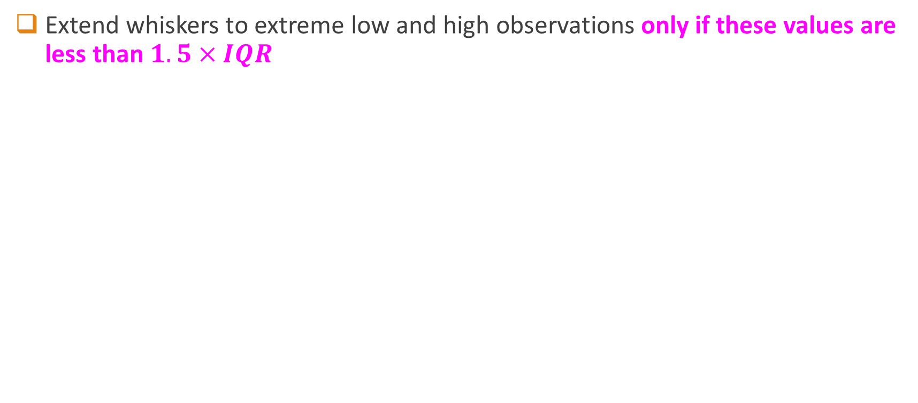
Boxplots with Outliers
Extend whiskers to extreme low and high observations only if these values are less than $1.5×IQR$

Slide 6
Drawing a Box Plot.
Example 1: Draw a Box plot for the data below
Q₁
Q₂
Q₃
4, 4, 5, 6, 8, 8, 8, 9, 9, 9, 10, 12
Lower Quartile = 5½
Upper Quartile = 9
Median = 8

Slide 7
Drawing a Box Plot.
Example 1: Draw a Box plot for the data below
Q₁
Q₂
Q₃
4, 4, 5, 6, 8, 8, 8, 9, 9, 9, 10, 12
Lower Quartile = 5½
Upper Quartile = 9
Median = 8
4
5
6
7
8
9
10
11
12

Slide 8
Drawing a Box Plot.
Example 2: Draw a Box plot for the data below
Q₁
Q₂
Q₃
3, 4, 4, 6, 8, 8, 8, 9, 10, 10, 15,
Lower Quartile = 4
Upper Quartile = 10
Median = 8
3
4
5
6
7
8
9
10
11
12
13
14
15

Slide 9
Drawing a Box Plot.
Question: Stuart recorded the heights in cm of boys in his class as shown below. Draw a box plot for this data.
Q_{L}
Q₂
Q_{u}
137, 148, 155, 158, 165, 166, 166, 171, 171, 173, 175, 180, 184, 186, 186
Lower Quartile = 158
Upper Quartile = 180
Median = 171
130
140
150
160
170
180
cm
190

Slide 10
Drawing a Box Plot.
Question: Gemma recorded the heights in cm of girls in the same class and constructed a box plot from the data. The box plots for both boys and girls are shown below. Use the box plots to choose some correct statements comparing heights of boys and girls in the class. Justify your answers.
Boys
130
140
150
160
170
180
cm
190
Girls
1. The girls are taller on average.
2. The boys are taller on average.
3. The girls show less variability in height.
5. The smallest person is a girl.
4. The boys show less variability in height.
6. The tallest person is a boy.

Slide 11
18, 34, 76, 29, 15, 41, 46, 25, 54, 38, 20, 32, 43, 22

Slide 12
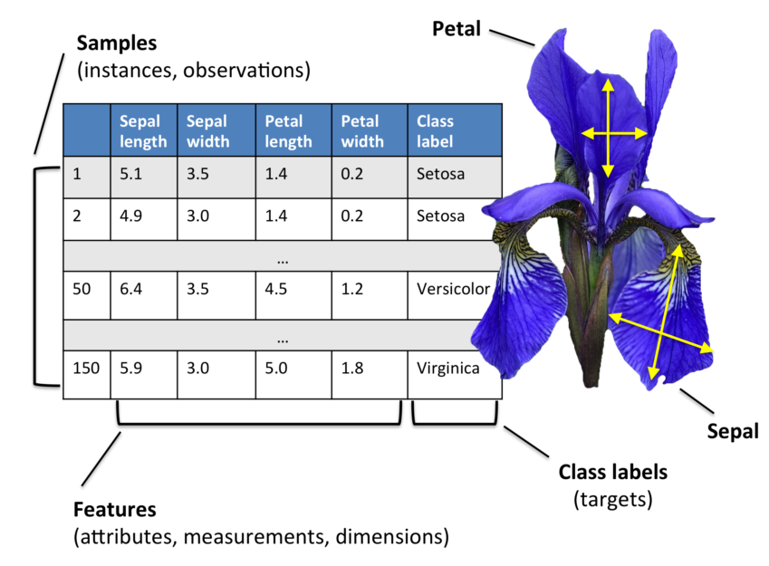
Recall this example from Lecture 2 (IRIS)

Slide 13
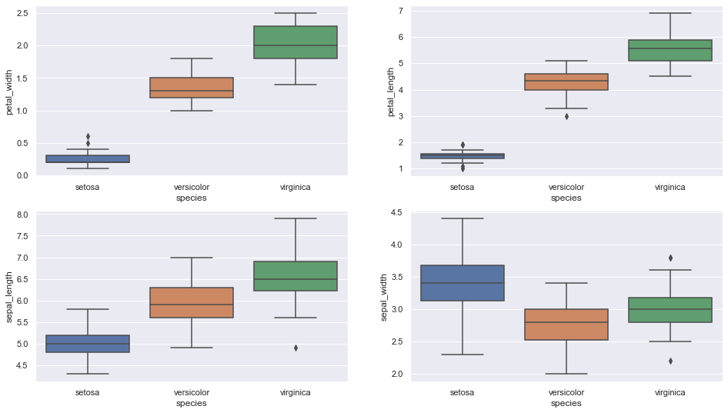
Boxplot for All Attributes of IRIS dataset

Slide 14
Insights from Boxplots of IRIS Dataset
Setosa is having smaller feature and less distributed
Versicolor is distributed in a average manner and average features
Virginica is highly distributed with large no .of values and features
Clearly the mean/ median values are being shown by each plots for various features(sepal length & width, petal length & width)

Slide 15
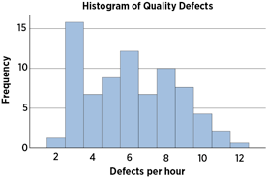
What is a histogram?
A frequency distribution shows how often each different value in a set of data occurs.
It looks very much like a bar chart, but there are important differences between them.

Slide 16
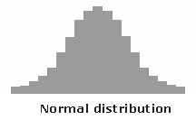
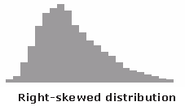
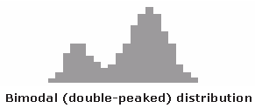
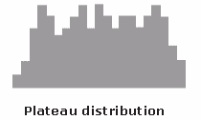
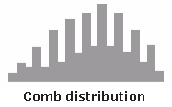

Typical Histogram Shapes
Credit: https://asq.org/quality-resources/histogram

Slide 17
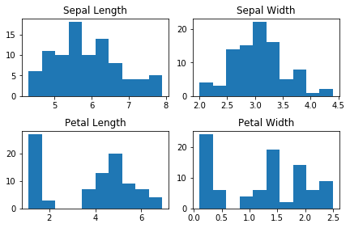
Histogram
When Data

Slide 18
Histogram
When data is Numerical

Slide 19
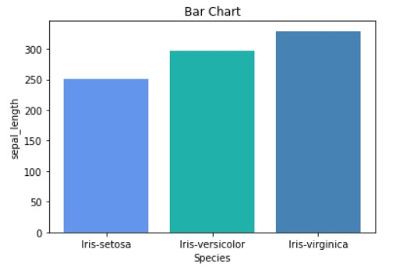
Barplot
When data is Categorical

Slide 20
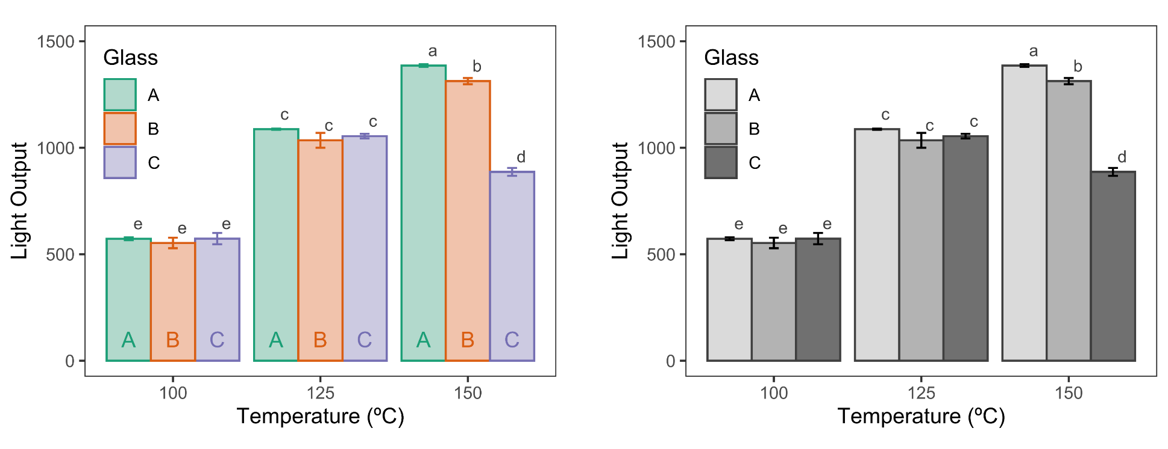
Barplot: Example 2

Slide 21
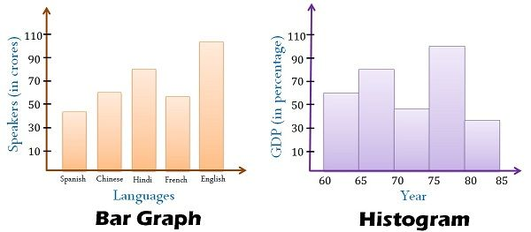
Differences in Barplot and Histogram
You can’t reorder bars in a histogram; you can in a bar chart
Convention: Bars touch in histogram, not in barplot

Slide 22
Differences Summary
BASIS FOR COMPARISON | HISTOGRAM | BAR GRAPH
Meaning | Histogram refers to a graphical representation, that displays data by way of bars to show the frequency of numerical data. | Bar graph is a pictorial representation of data that uses bars to compare different categories of data.
Indicates | Distribution of non-discrete variables | Comparison of discrete variables
Presents | Quantitative data | Categorical data
Spaces | Bars touch each other, hence there are no spaces between bars | Bars do not touch each other, hence there are spaces between bars.
Elements | Elements are grouped together, so that they are considered as ranges. | Elements are taken as individual entities.
Can bars be reordered? | No | Yes
Width of bars | Need not to be same | Same
Credit: https://keydifferences.com/difference-between-histogram-and-bar-graph.html

Slide 23
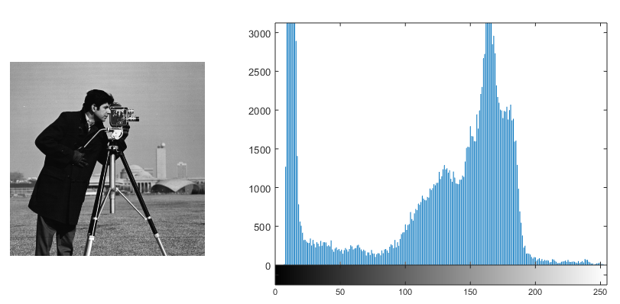
Histogram for Images
What does the histogram for an image represent?

Slide 24
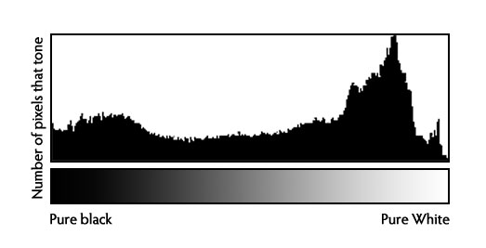
Histogram for Images
What does the histogram for an image represent?

Slide 25
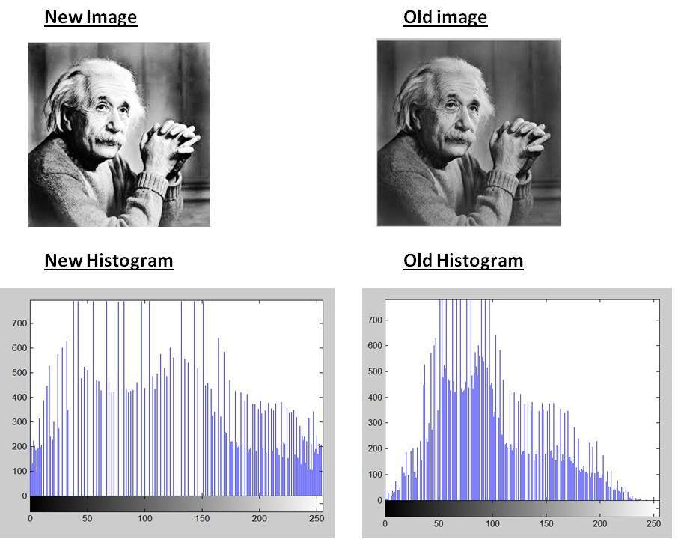
Histogram: Important for Photographers

Slide 26

How we Precieve color
Notes:
You think you see million of colors but you basically just see three colors Red Green and Blue

Slide 27
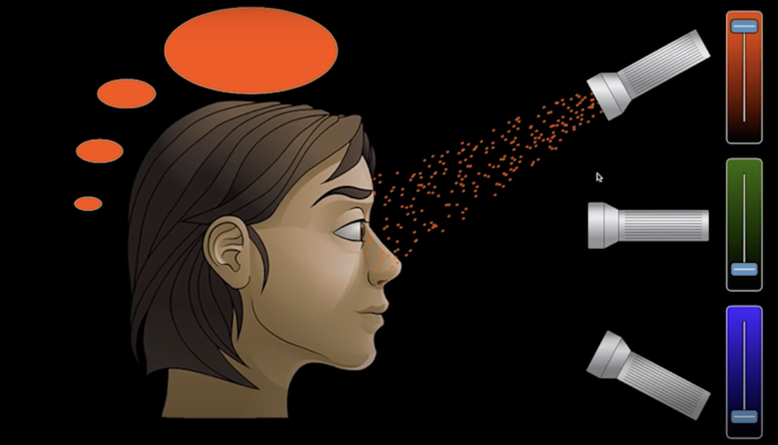
Just Red Pixel

Slide 28
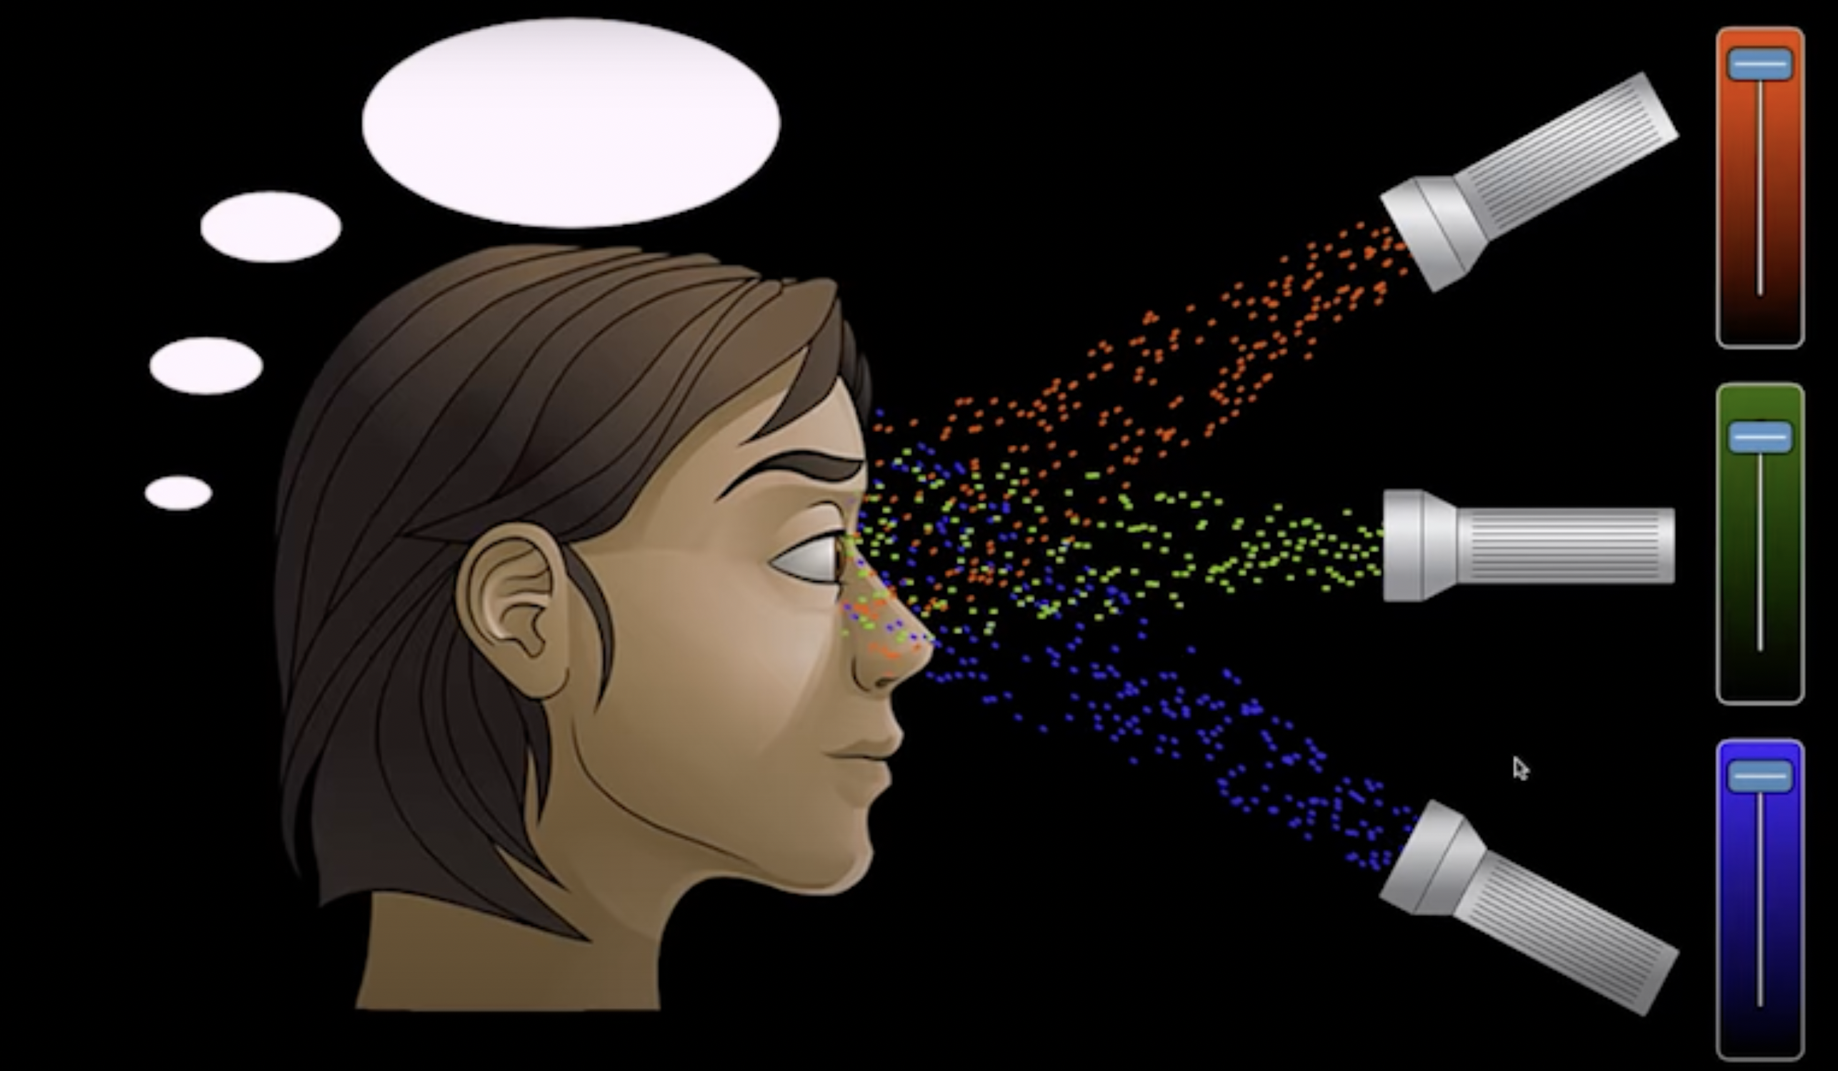
All Pixels with full intensity – You precieve White

Slide 29
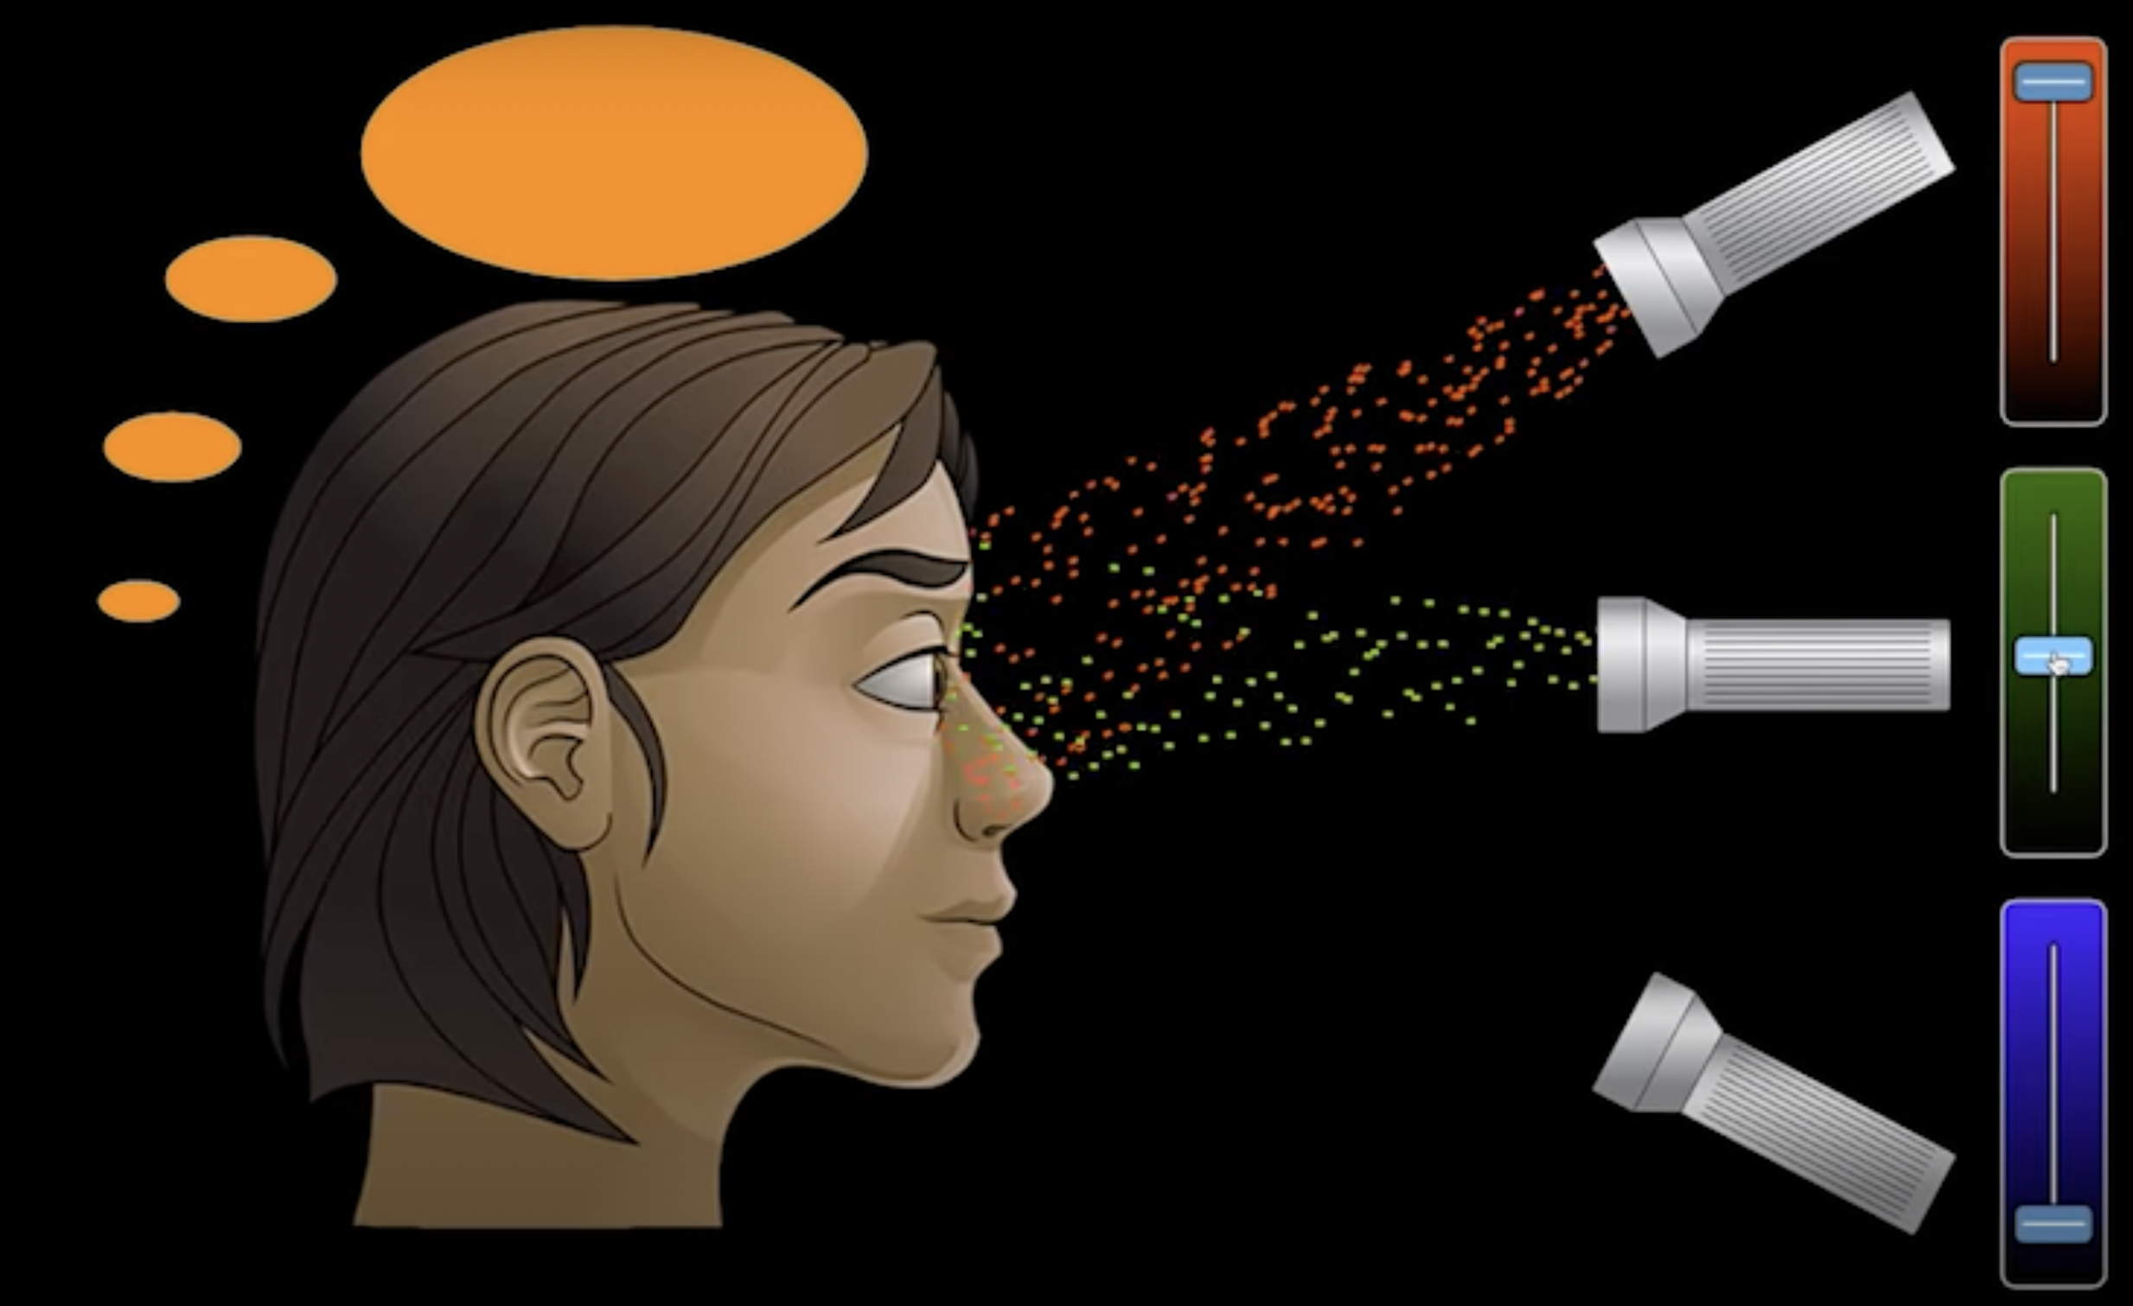
How you see Orange

Slide 30
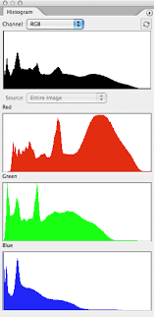
Histogram for Color Images

Slide 31
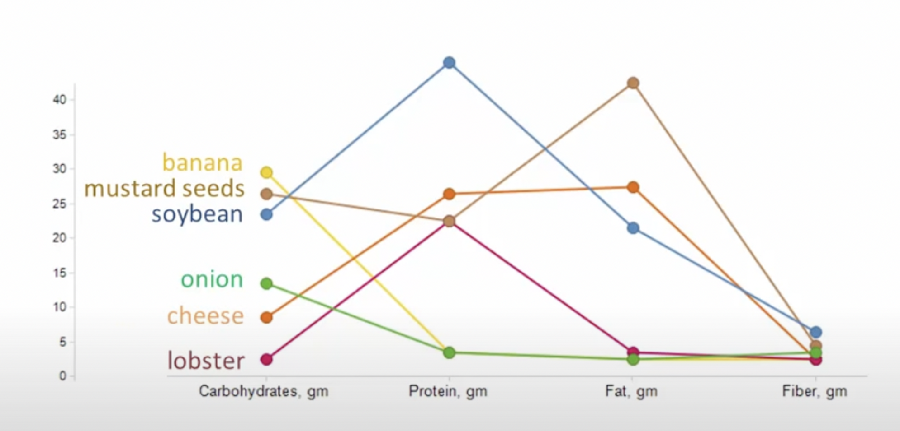
Multidimensional Line Chart

Slide 32
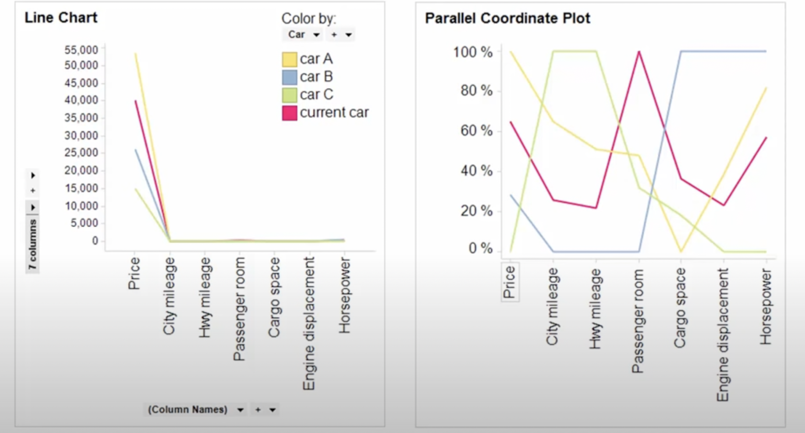
Variables with completely different scale
Notes:
If we are focusing on Low Price and City and Hwy Milage may be CAR C should be our choice but we have to compromise on Passenger room and engine displacement

Slide 33
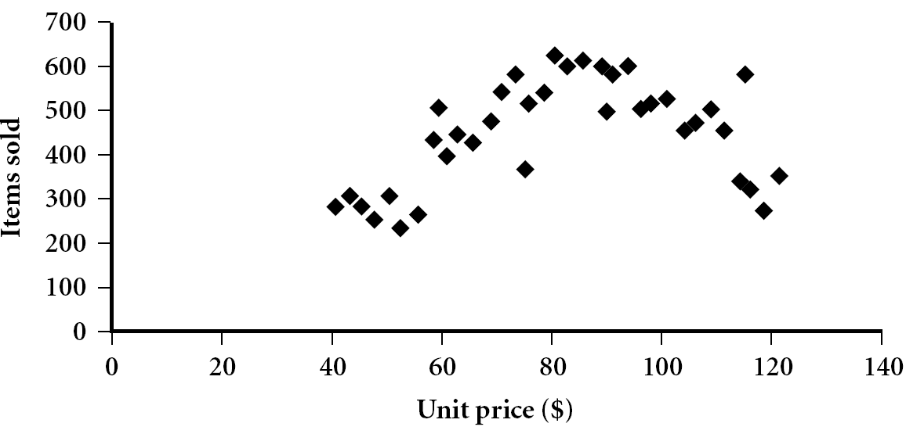
Scatter plot
Provides a first look at bivariate data to see clusters of points, outliers, etc
Each pair of values is treated as a pair of coordinates and plotted as points in the plane

Slide 34
Positively and Negatively Correlated Data
The left half fragment is positively correlated
The right half is negative correlated

Slide 35
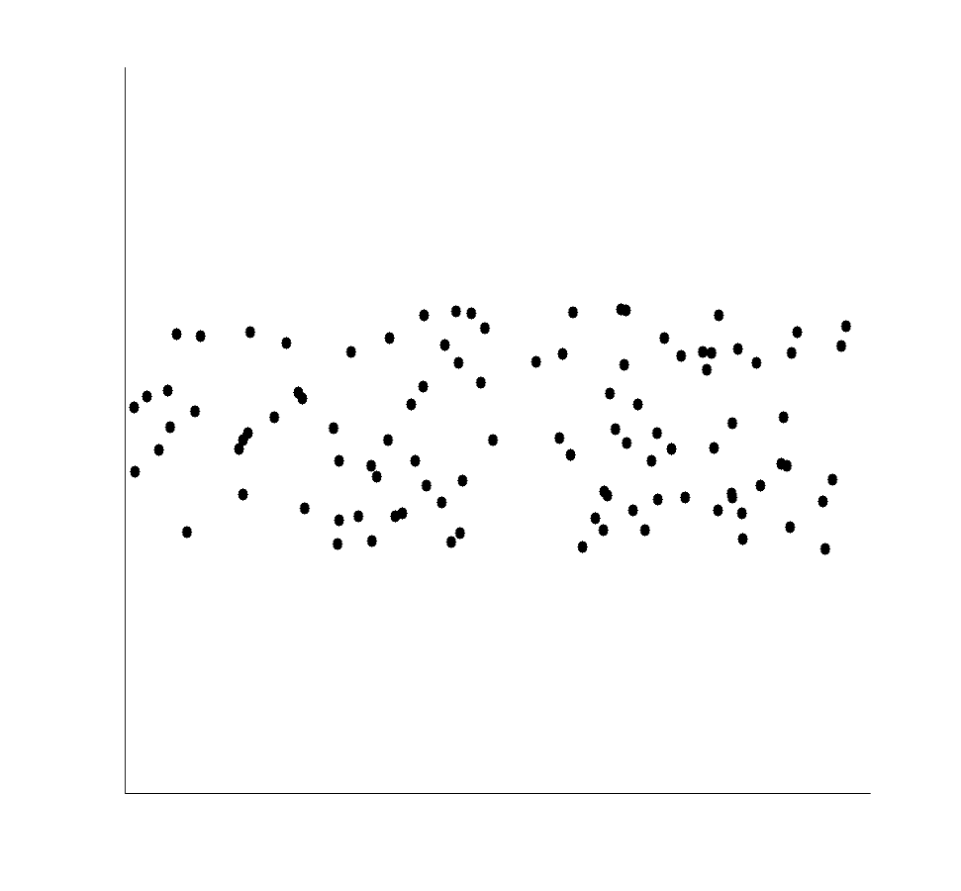
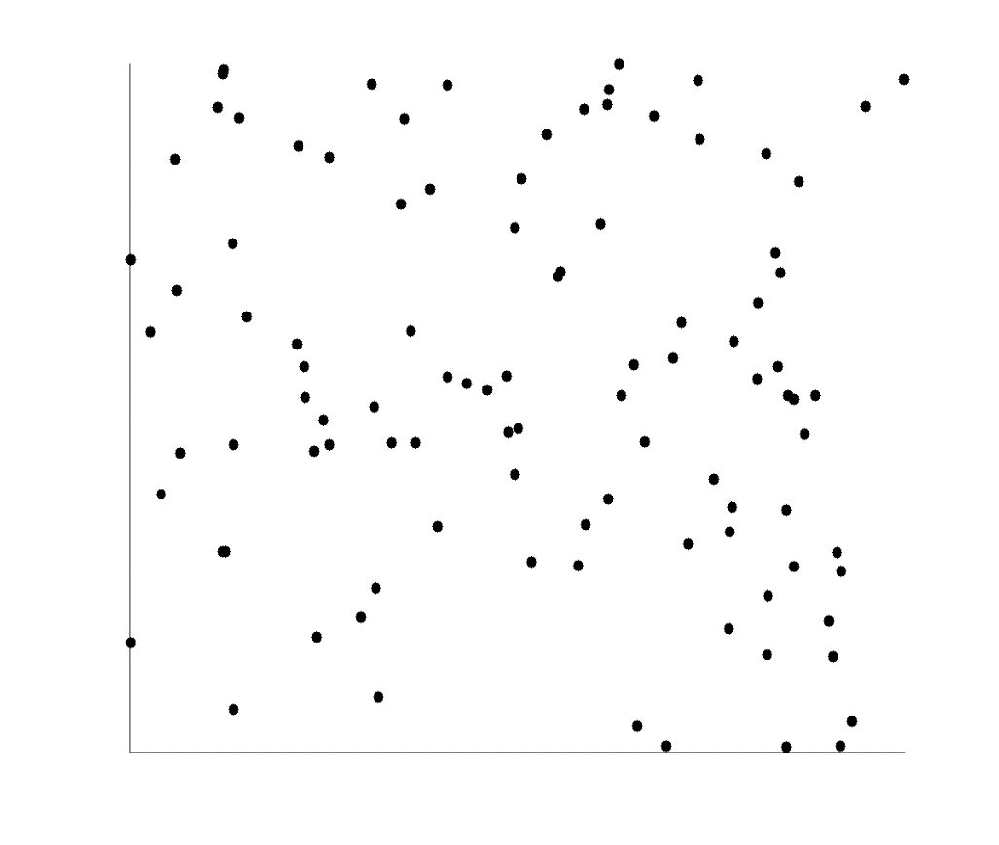
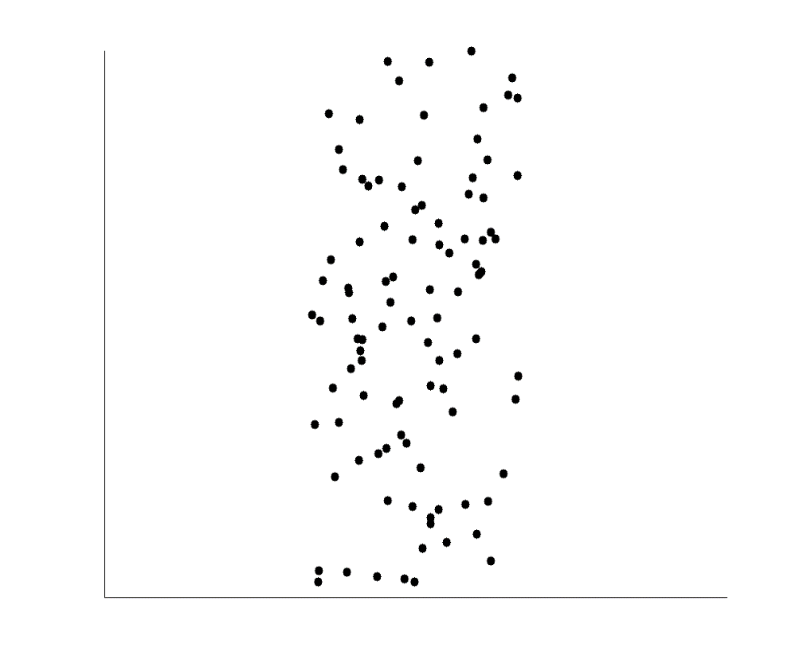
Uncorrelated Data

Slide 36
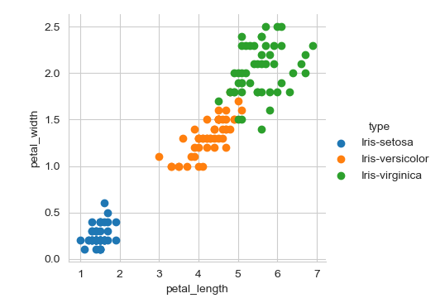
Scatter Plot

Slide 37
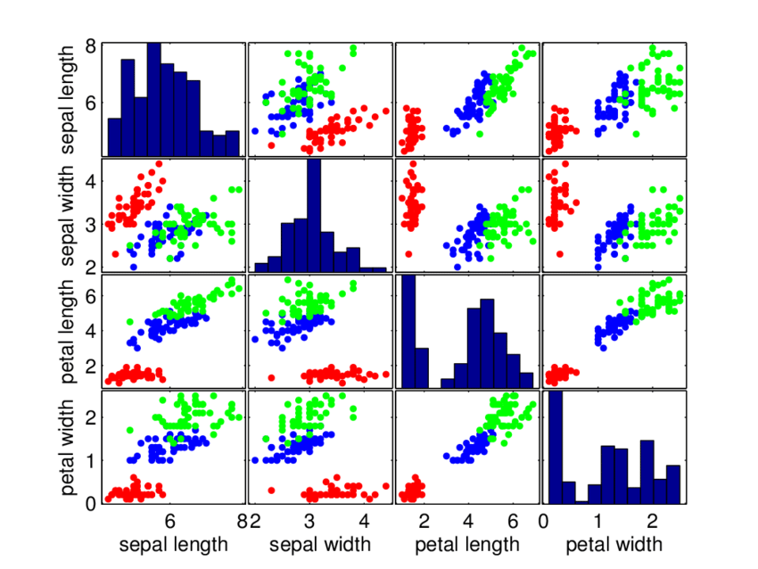
Scatter Plot Matrix
red = Satosa blue = Versicolor green = Virginica

Slide 38
Scatter Plot and Parallel Coordinates Insights
High correlation between petal length and petal width columns.
Setosa has both low petal length and width
Versicolor has both average petal length and width
Virginica has both high petal length and width.
Sepal width for setosa is high and length is low.
Versicolor have average values for sepal dimensions.
Virginica has small width but large sepal length
What is correlation?

Slide 39
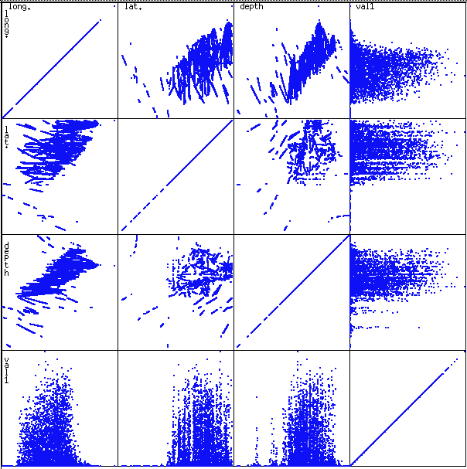
Scatterplot Matrices
Used by ermission of M. Ward, Worcester Polytechnic Institute
Matrix of scatterplots (x-y-diagrams) of the k-dim. data [total of (k2/2-k) scatterplots]

Slide 40
Quantile Plot
Effective for univariate data distribution
Univariate data has only one variable (i.e., feature or column or dimension or attribute)
Multivariate data has two or more variables
What is univariate data analysis?

Slide 41
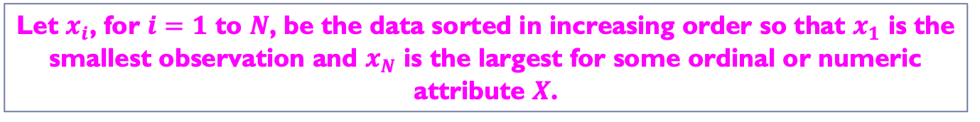
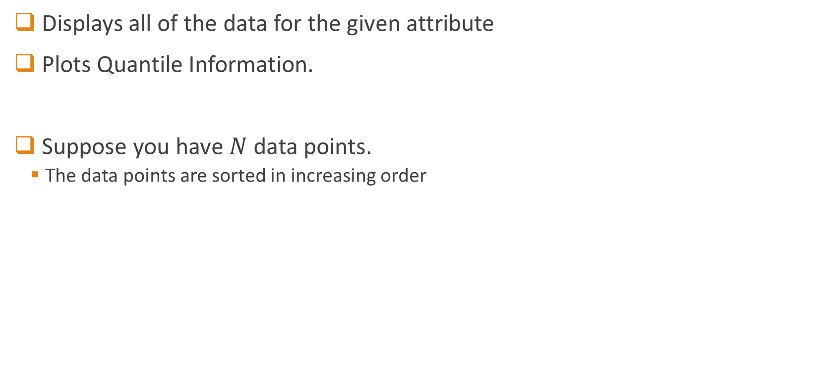
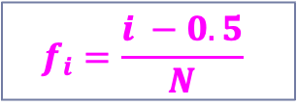
Quantile Plot
Displays all of the data for the given attribute
Plots Quantile Information.
Suppose you have $N$ data points.
The data points are sorted in increasing order
Let $x_{i}$, for $i=1$ to $N$, be the data sorted in increasing order so that $x_{1}$ is the smallest observation and $x_{N}$ is the largest for some ordinal or numeric attribute $X$.
Each observation $x_{i}$ is paired with a percentage $f_{i}$ which indicates that approximately $f_{i}×100\%$ of the data are below the value $x_{i}$.
$$f_{i}=\frac{i −0.5}{N}$$

Slide 42
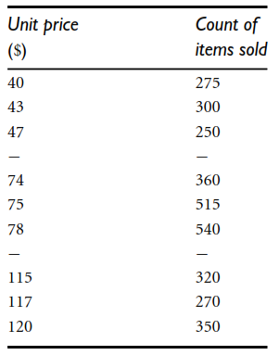
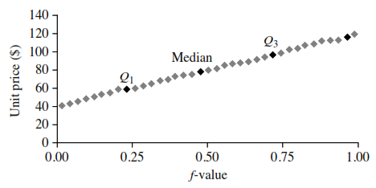
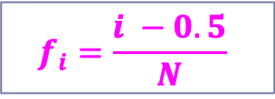
Quantile Plot: Example
$$f_{i}=\frac{i −0.5}{N}$$

Slide 43
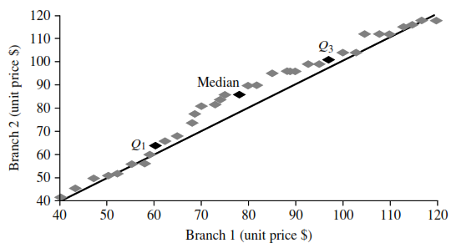
q-q Plot
25% of items sold at branch 1 were less than or equal to $60, while 25% of items sold at branch 2 were less than or equal to $64.
Unit Prices sold at two branches
Each point shows the unit price of items sold at branch 1 versus branch 2 for each quantile
The darker points correspond to the data for Q1, the median, and Q3 respectively
We will take equal number of data points for each branch (i.e., length of x and y axis is the same)

Slide 44
q-q Plot
At median, 50% of items sold at branch 1 were less than $78 while 50% of items at branch 2 were less than $85
Unit Prices sold at two branches
Each point shows the unit price of items sold at branch 1 versus branch 2 for each quantile
The darker points correspond to the data for Q1, the median, and Q3 respectively
We will take equal number of data points for each branch (i.e., length of x and y axis is the same)

Slide 45
q-q Plot
Unit Prices sold at two branches
Each point shows the unit price of items sold at branch 1 versus branch 2 for each quantile
The darker points correspond to the data for Q1, the median, and Q3 respectively
Overall, items sold at branch 1 tend to be lower in price than those at branch 2
We will take equal number of data points for each branch (i.e., length of x and y axis is the same)

